Slide 1
Welcome
Reading domains and strategies to help at home.

Slide 2
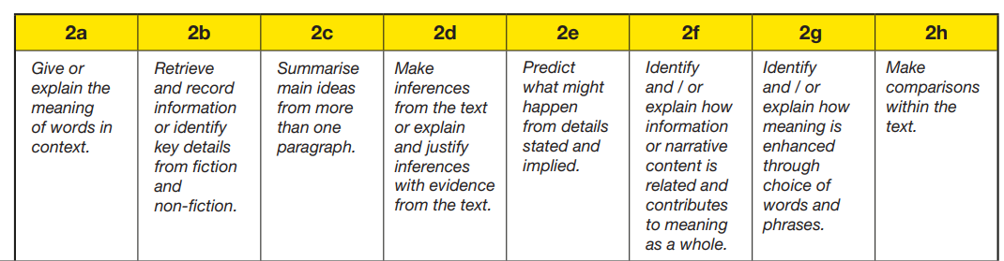
Reading Domains

Slide 3
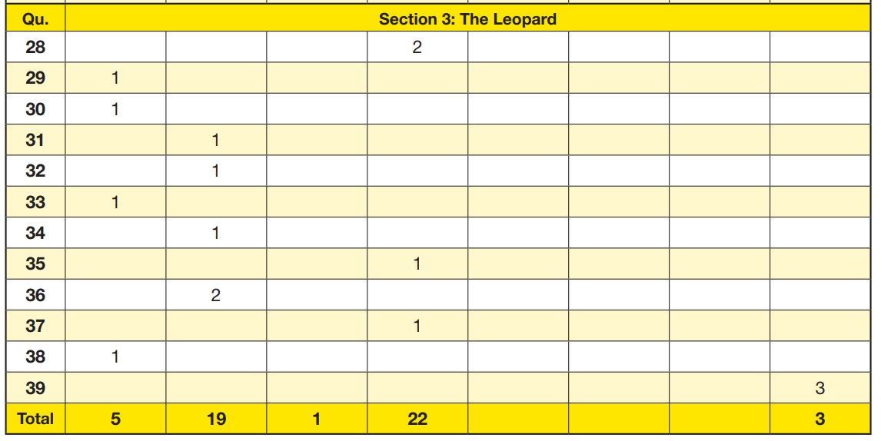
2024

Slide 4
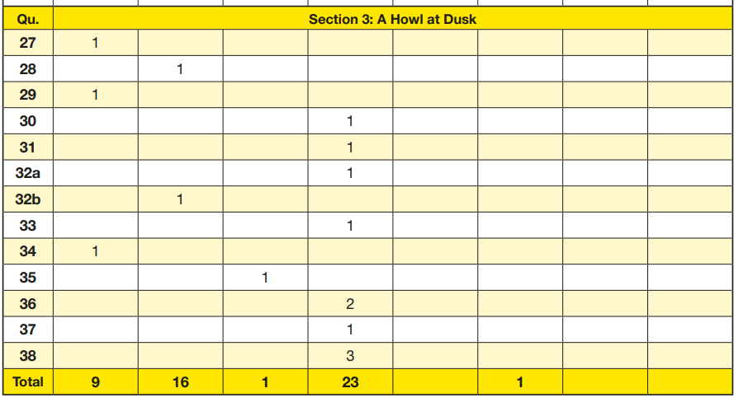
2023

Slide 5
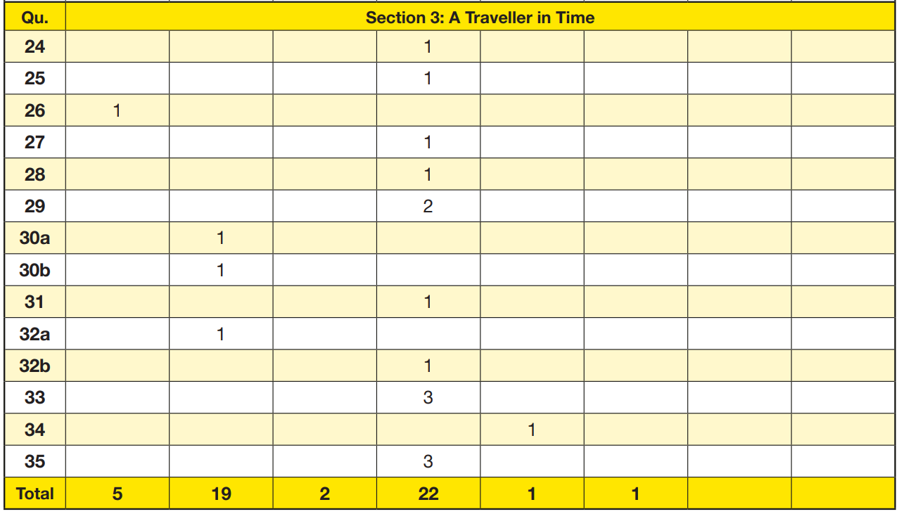
2022

Slide 6



What is inference?
When people write or speak, they rarely tell you everything – and thank goodness. Think about these two sentences:
1. Make a cheese sandwich.
2. Go to the kitchen, get two slices of bread, get butter and
cheese from the fridge, spread butter thinly on one side of both pieces of bread, cut thin slices of cheese, arrange the cheese on the buttered side of one slice of bread, put the other slice on top of the cheese (buttered side down) and press down to make a sandwich.

Slide 7
What is inference?
Sentence 1 gets straight to the point. It tells you
what you really want to know and assumes that
you can work out the rest.
Sentence 2 might be accurate but you were probably
either bored or annoyed by all the detail.
Sentence 1 expects you to use inference – to fill in the gaps yourself. That means the speaker or writer can focus on the more interesting information.
Other ways of describing inference include:
joining the dots
reading between the lines.

Slide 8

What is inference?
It’s not just the words that can help you to infer what is happening.
What might you guess is happening in this sentence?
Trent felt a sharp pain in his lip and was soon flying through the air.
Discuss your suggestions, then click to see if your ideas change.
Now, what do you think is happening?
Remember, you have not been told what is going on – you’ve looked at the picture and drawn your own inferences.

Slide 9

Types of inference in reading
Inference can happen both while you are reading and when you have finished.
On-line inference
This happens while you are reading. It comes so naturally that you hardly have to think about it.
Off-line inference
This happens after you have finished reading and you’ve had the chance to think about it for a while.

Slide 10





Whole Class Reading

Slide 11
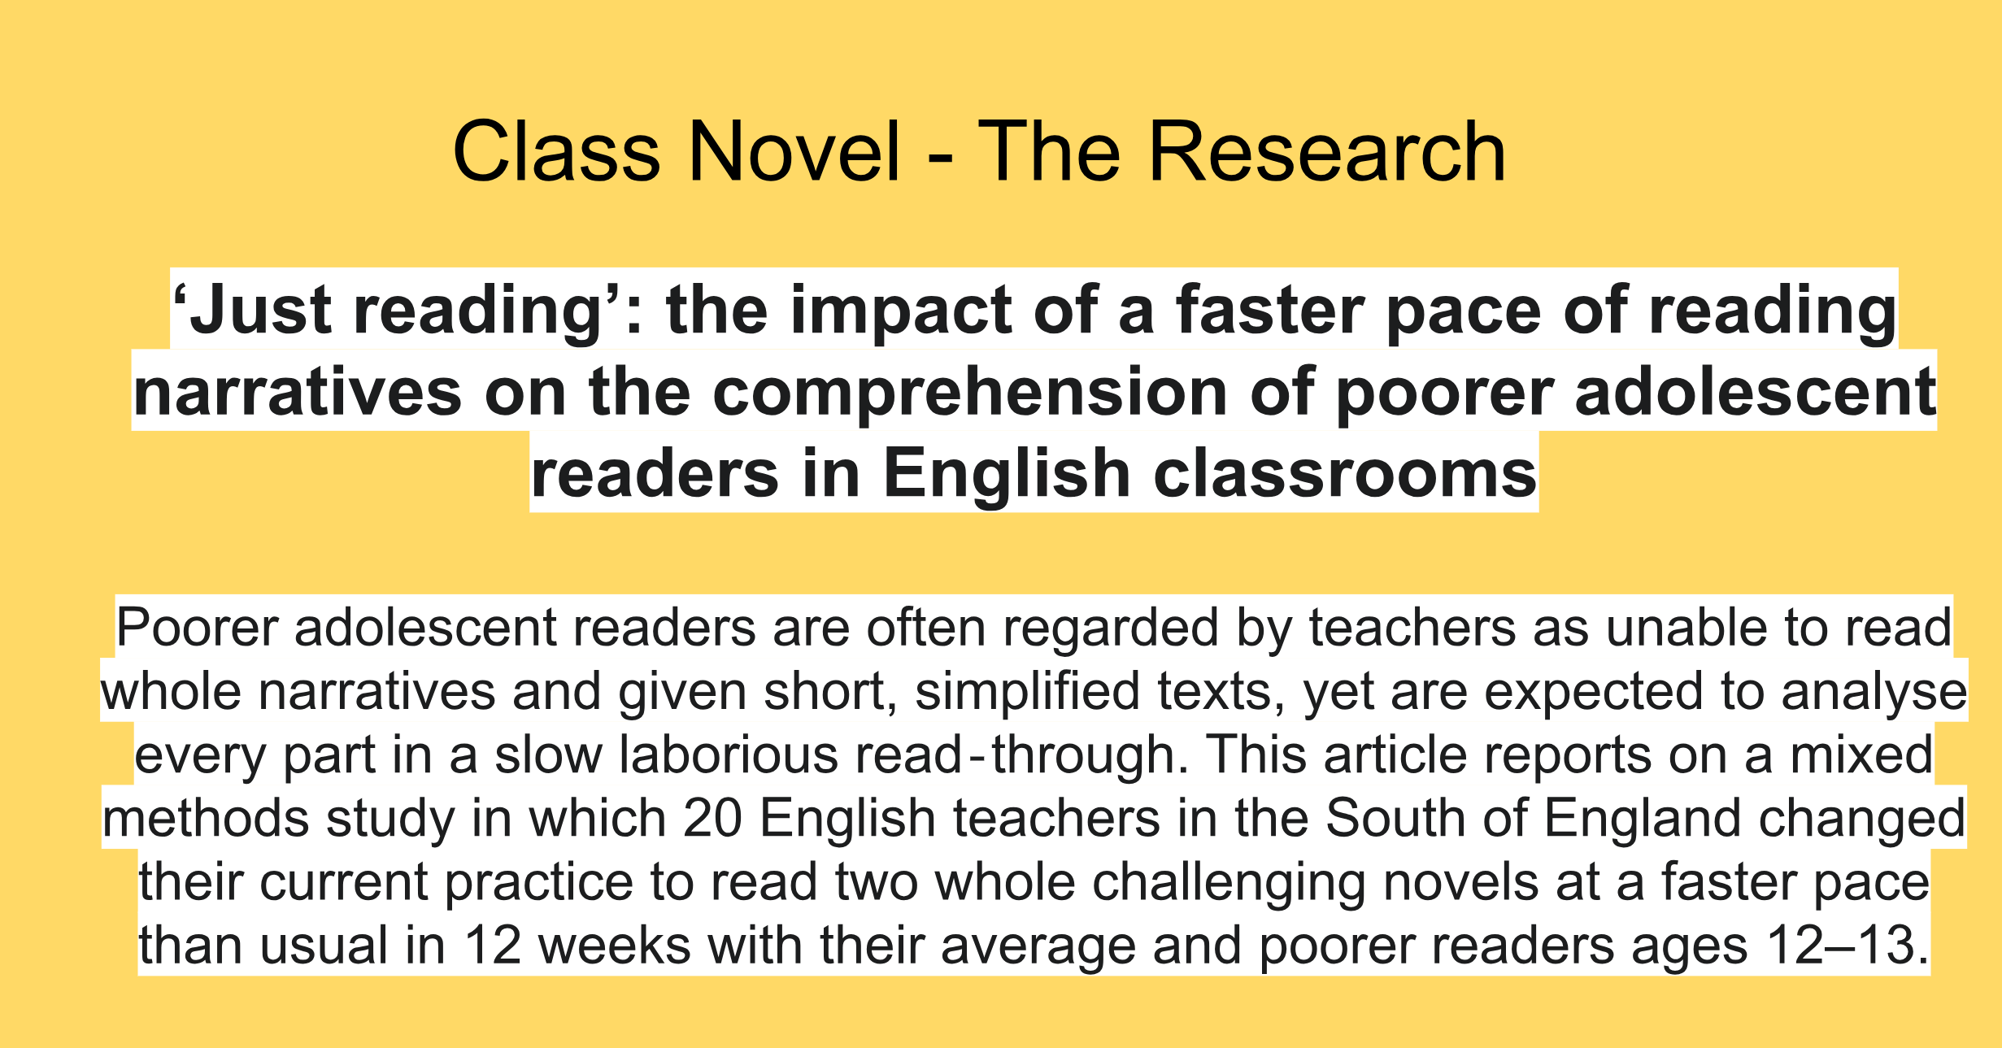

Slide 12
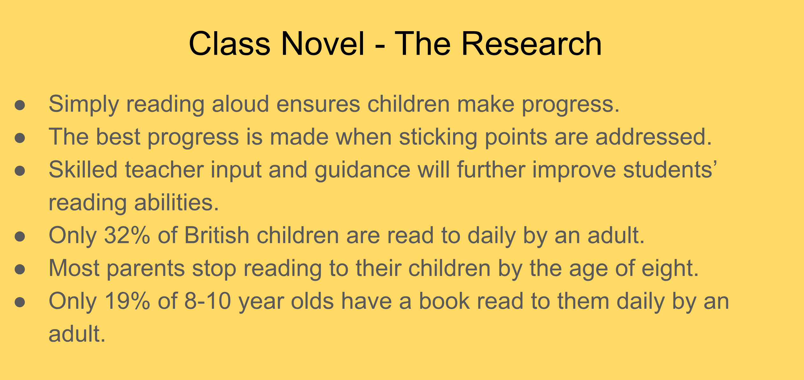

Slide 13
Test skills
Class task board:
Read Q1 of your comprehension.
Use a ruler to guide your reading, line by line, in the text.
When you have found the answer to Q1, use a highlighter to highlight it in the text.
Transfer the answer to your question.
Repeat steps 1-4 for the next question.

Slide 14
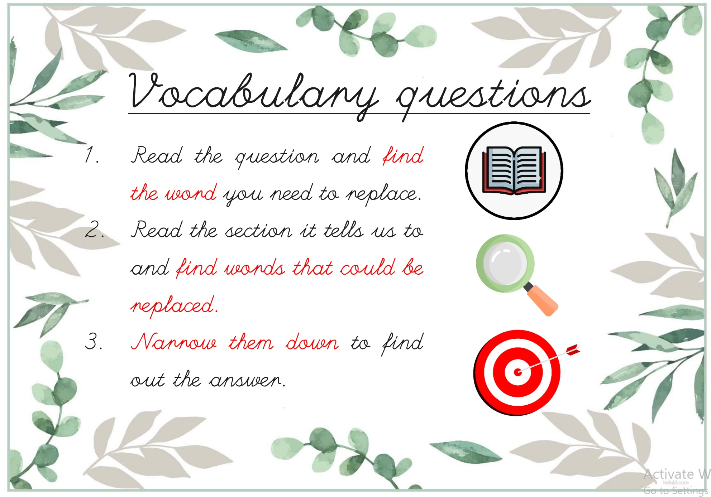

Slide 15
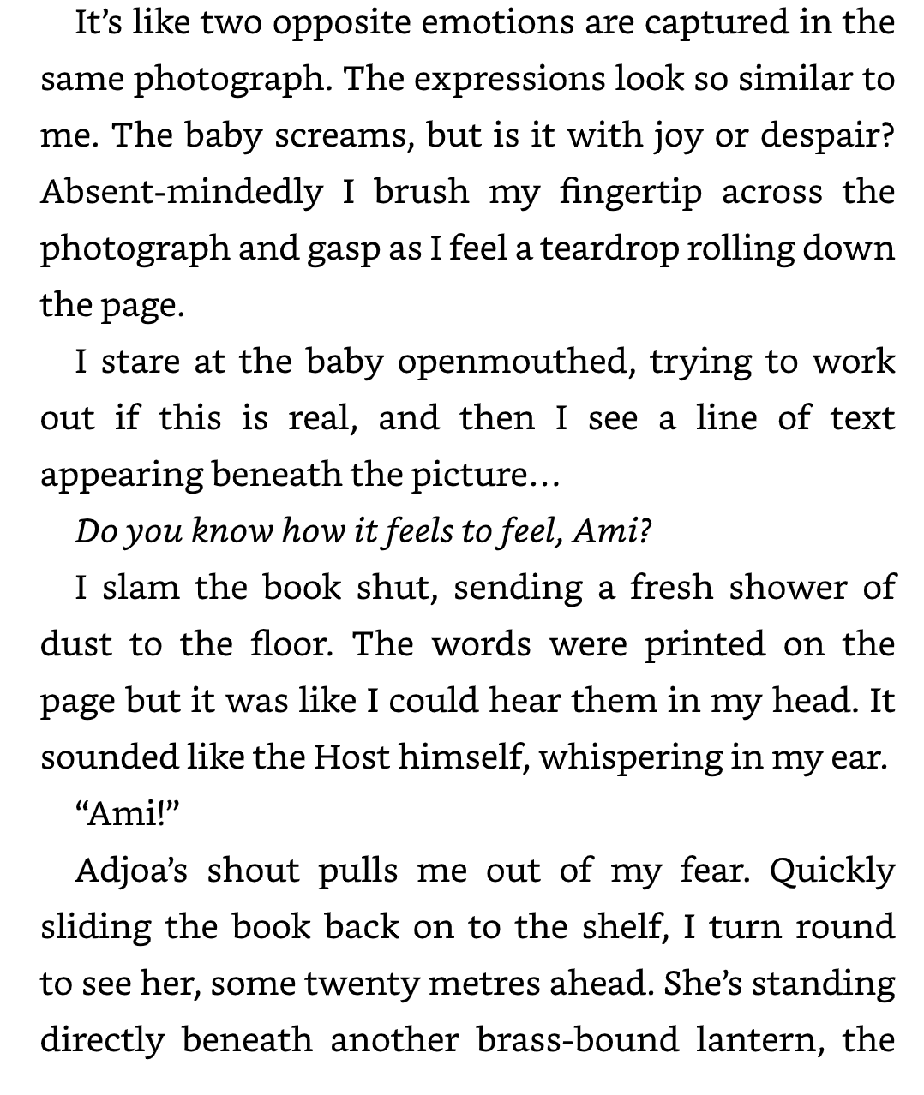
Words in Context
Find and copy one word that is closest in meaning to ‘caught’.
_________________________________
Find and copy one word that is closest in meaning to ‘emerging’.
_________________________________

Slide 16
Ways to help at home with reading:
Vocabulary (Domain 2a)
Understanding words in context and their meanings
Play word games: Use apps, flashcards, or games like Scrabble or Bananagrams to build vocabulary.
Explore new words: While reading, pause and ask, "What do you think this word means?“ OR “ What could a synonym of this word be?” Encourage looking up unfamiliar words in a dictionary.
Word of the day: Learn a new word daily and try to use it in sentences together

Slide 17
Ways to help at home with reading:
Retrieval (Domain 2b)
Finding specific information in the text
Ask factual questions: After reading a passage, ask straightforward questions:
"What happened in this part?" or "Who is the main character?"
Highlight answers: Practice finding answers in the text by highlighting or underlining key parts.
Use reading challenges: Give a time-limited task to find specific information, like "Can you find what year this story is set in 30 seconds?”

Slide 18
Ways to help at home with reading:
Inference (Domain 2d)
Reading between the lines and understanding implied meanings
Ask "Why?" and "How?" questions: For example, "Why do you think the character felt this way?" or "How do you know the storm is getting worse?” To take this even further, ask them to find the evidence to support it in their book.

Slide 19
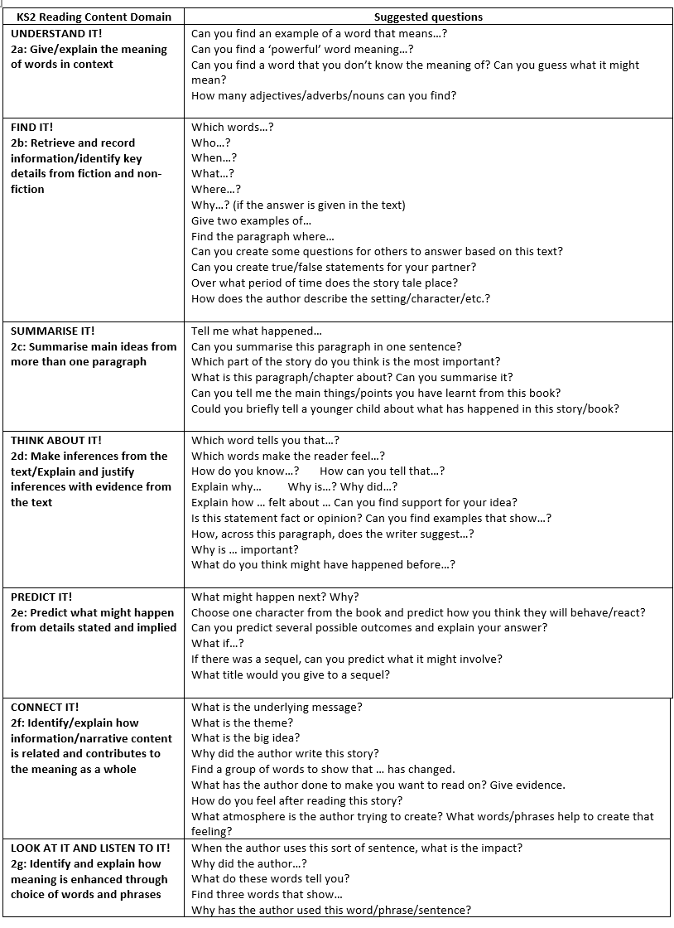
Ways to help at home with reading:
Discuss What They Read
Ask Questions: Engage your child in discussions about the books they are reading.
Ask questions that focus on retrieval ‘Who…, where…, when…, why…?’, understanding vocabulary ‘Can you find an example of a word that means…?’ and inference ‘How do you know…? How can you tell that…? Explain why…’
This relates to all types of reading at home.

